Slide 1
CALCULUS
Chapter 1

Slide 2
Objectives
Four ways to represent a function
Basis functions and the transformations of functions
Calculating limits of functions
(limits at a point, limits involving Infinity)
Verifying continuity of a function

Slide 3
FUNCTIONS AND LIMITS
1.1
Functions and
Their Representations

Slide 4
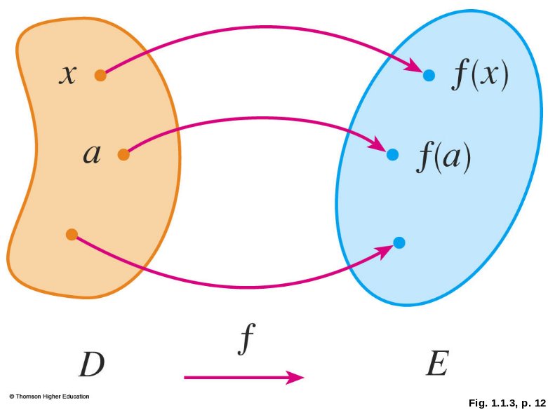
FUNCTION
A function f is a rule that assigns to each element x in a set D exactly one element, called f(x), in a set E.
The set D is called the domain of the function f.
The range of f is the set
of all possible values
of f(x) as x varies
throughout the domain.

Slide 5
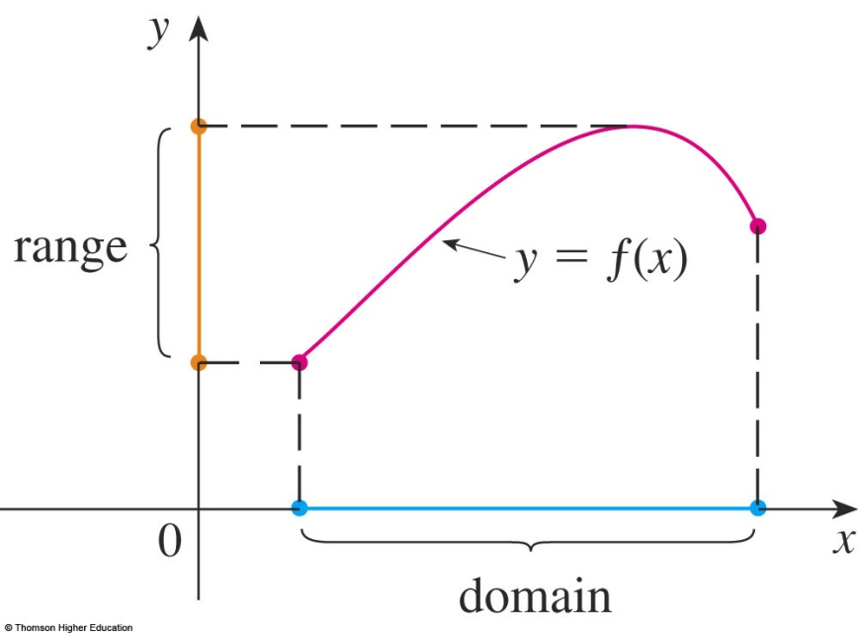
GRAPH
The graph of f is the set of all points (x, y) in the coordinate plane such that y = f(x) and x is in the domain of f.
The graph of f also allows us to picture:
  The domain of f on the x-axis
  Its range on the y-axis

Slide 6
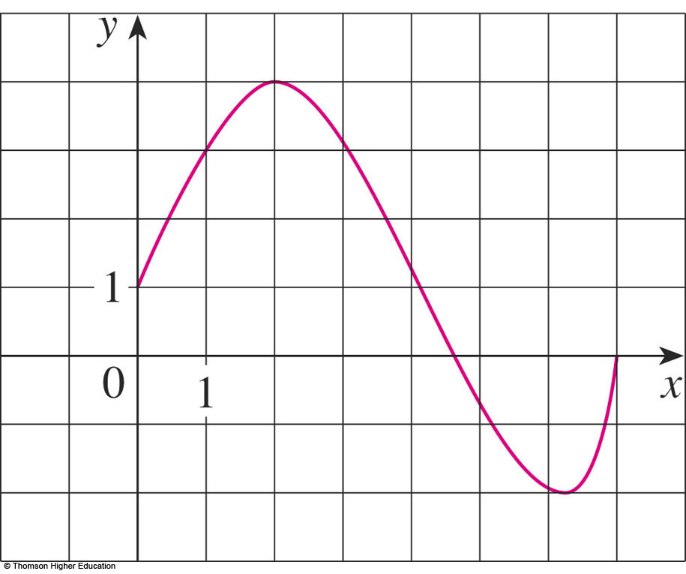
GRAPH
Example 1
The graph of a function f is shown.
Find the values of f(1) and f(5).
What is the domain and range of f ?
f(1) = 3
f(5) ≈ - 0.7
D = [0, 7]
Im(f) = [-2, 4]

Slide 7
REPRESENTATIONS
DISCUSSION
Find the the domain and region of the functions ( if it is a function).
a.
b.

Slide 8
REPRESENTATIONS OF FUNCTIONS
There are four possible ways to represent a function:
  Algebraically (by an explicit formula)
  Visually (by a graph)
  Numerically (by a table of values)
  Verbally (by a description in words)

Slide 9
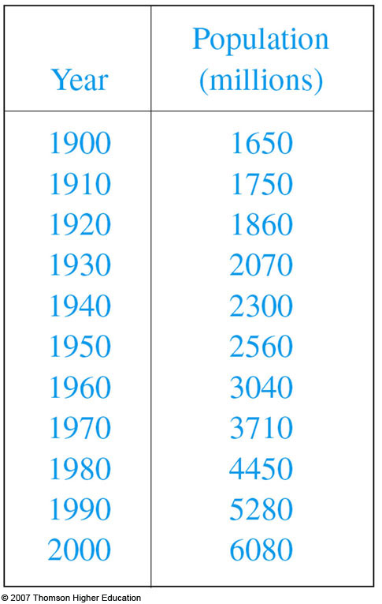
EXAMPLE B
The human population of the world P depends on the time t.
  The table gives estimates of the
  world population P(t) at time t,
  for certain years.
  However, for each value of the
  time t, there is a corresponding
  value of P, and we say that
  P is a function of t.

Slide 10
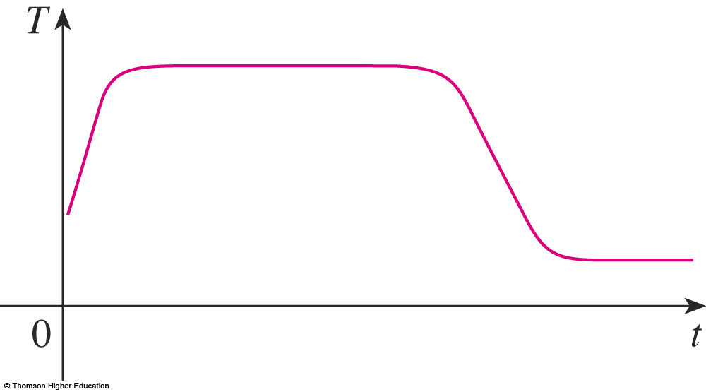
REPRESENTATIONS
Example 4
"When you turn on a hot-water faucet, the temperature T of the water depends on how long the water has been running".
Draw a rough graph of T as a function of the time t that has elapsed since the faucet was turned on.

Slide 11
THE VERTICAL LINE TEST
A curve in the xy-plane is the graph of a function of x if and only if no vertical line intersects the curve more than once.

Slide 12
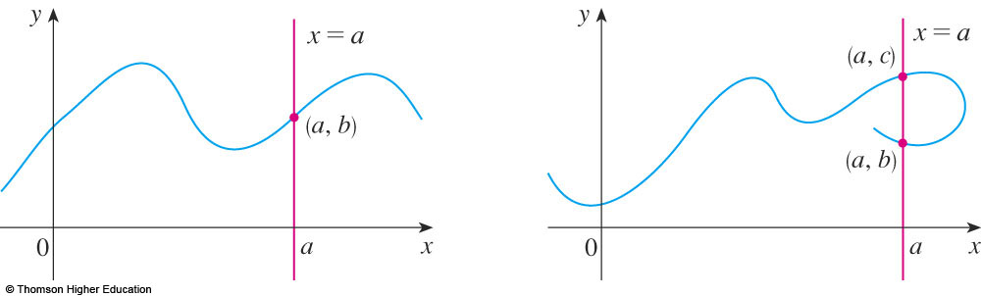
THE VERTICAL LINE TEST
The reason for the truth of the Vertical Line Test can be seen in the figure.

Slide 13
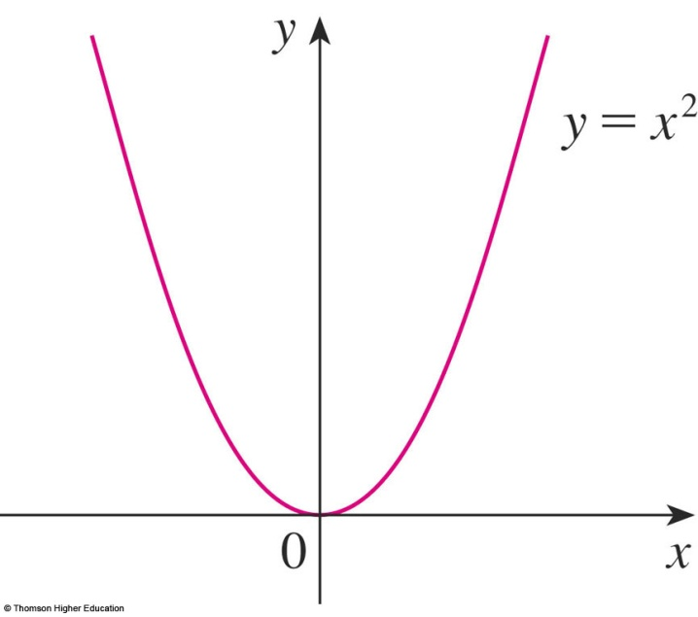
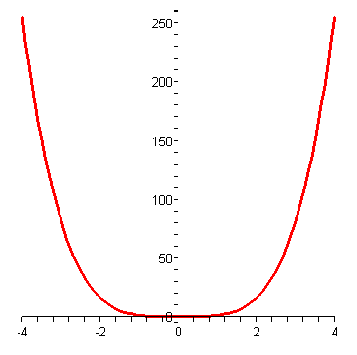
SYMMETRY: EVEN FUNCTION
movie
If a function f satisfies:
f(-x) = f(x), ∀ x ∈ D
then f is called an even function.
  The geometric significance of an even function is that its graph is symmetric with respect to the y-axis.
y = x⁴

Slide 14
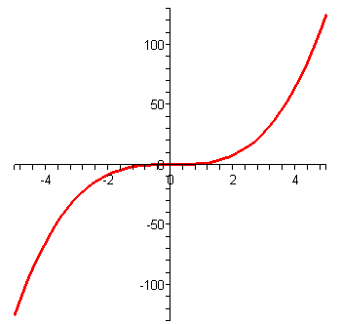
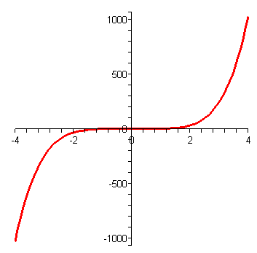
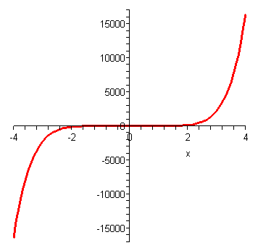
SYMMETRY: ODD FUNCTION
movie
If f satisfies:
f(-x) = - f(x), ∀ x ∈ D
then f is called an odd function.
  The graph of an odd function is symmetric about the origin.
y = x³
y = x⁵
y = x⁷

Slide 15
Example
Let f be an odd function. If (-3,5) is on the graph of f then
which point is also on the graph of f?
a. (3,5) b. (-3,-5) c. (3,-5) d. All of the others
Answer: c

Slide 16
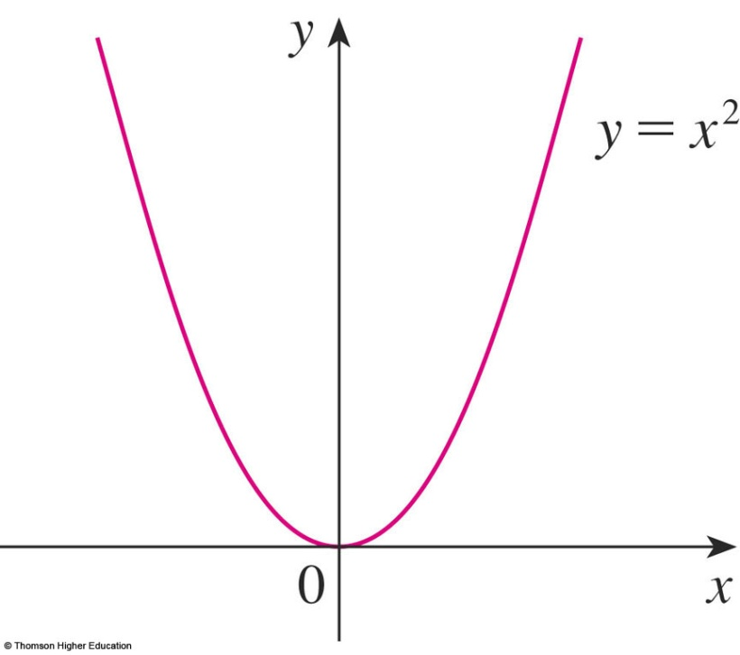
INCREASING AND DECREASING FUNCTIONS
A function f is called increasing on an interval I if:
f(x₁) < f(x₂) whenever x₁ < x₂ in I
It is called decreasing on I if:
f(x₁) > f(x₂) whenever x₁ < x₂ in I

Slide 17
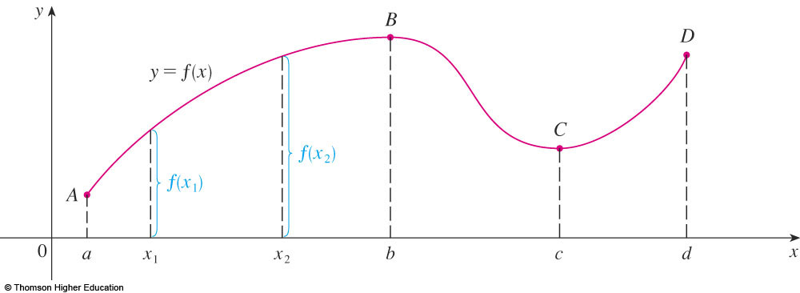
INCREASING AND DECREASING FUNCTIONS
The function f is said to be increasing on the interval [a, b], decreasing on [b, c], and increasing again on [c, d].

Slide 18
FUNCTIONS AND MODELS
1.2
MATHEMATICAL MODELS:
A CATALOG OF
ESSENTIAL FUNCTIONS
In this section, we will learn about:
The purpose of mathematical models.

Slide 19

MATHEMATICAL MODELS
A mathematical model is a mathematical description—often by means of a function or an equation—of a real-world phenomenon such as:
  Size of a population
  Demand for a product
  Speed of a falling object
  Life expectancy of a person at birth
  Cost of emission reductions

Slide 20
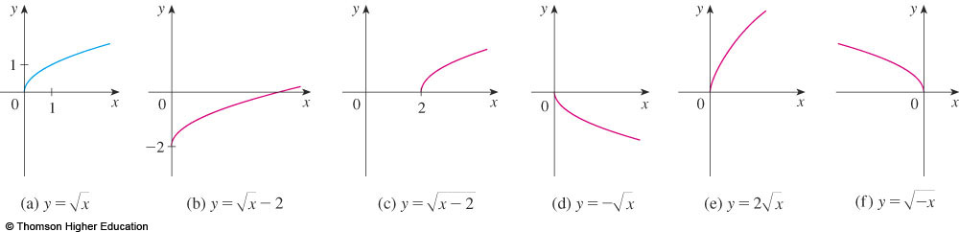
TRANSFORMATIONS
Label the following graph from the graph of
the function y=f(x) shown in the part (a)
y=f(x)-2, y=f(x-2), y=-f(x), y=2f(x), y=f(-x)?

Slide 21
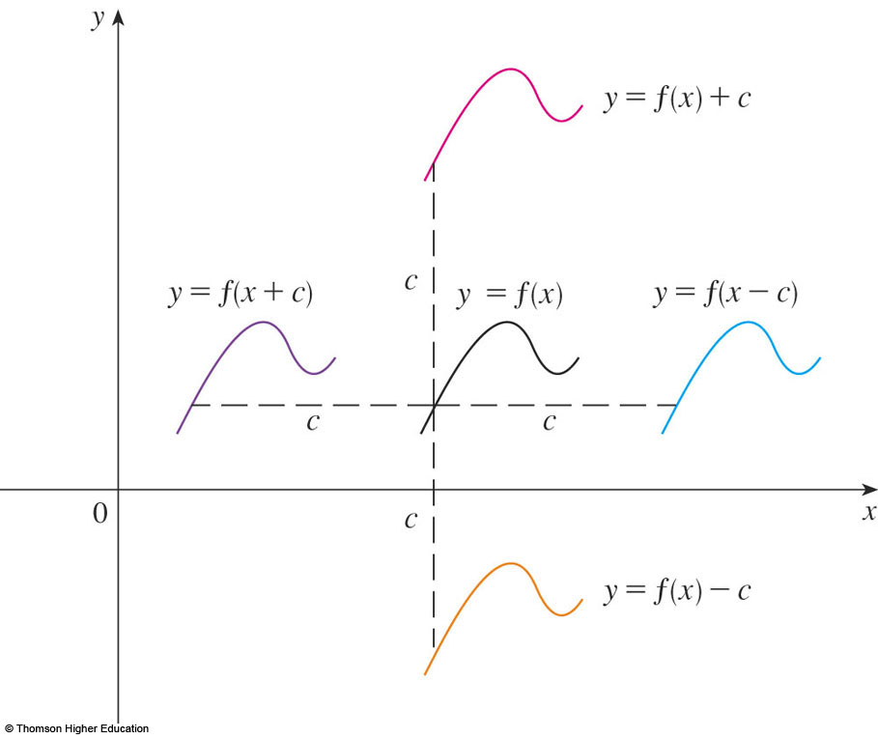
SHIFTING
Suppose c > 0.
  To obtain the graph of
  y = f(x) + c, shift the
  graph of y = f(x)
  a distance c units upward.
  To obtain the graph
  of y = f(x) - c, shift
  the graph of y = f(x)
  a distance c units
  downward.
Why don’t we consider the case c<0?

Slide 22
SHIFTING
  To obtain the graph of y = f(x - c), shift the graph of y = f(x) a distance c units to the right.
  To obtain the graph
  of y = f(x + c), shift
  the graph of y = f(x)
  a distance c units to
  the left.

Slide 23
NEW FUNCTIONS FROM OLD FUNCTIONS
Label the following graph from the graph of
the function y=f(x) shown in the part (a)
y=f(x)-2, y=f(x-2), y=-f(x), y=2f(x), y=f(-x)?

Slide 24
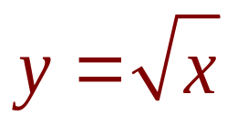
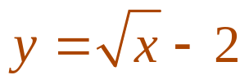
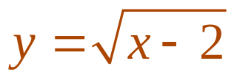
NEW FUNCTIONS FROM OLD FUNCTIONS
Label the following graph from the graph of
the function shown in the part (a):
y=f(x)-2, y=f(x-2), y=-f(x), y=2f(x), y=f(-x)?
by shifting 2 units downward.
by shifting 2 units to the right.

Slide 25
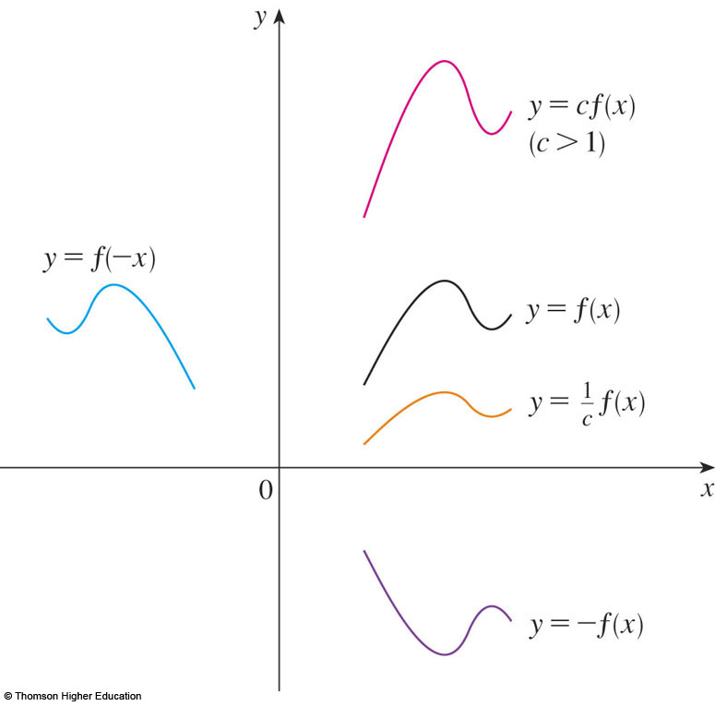
TRANSFORMATIONS
Suppose c > 1.
  To obtain the graph
  of y = cf(x), stretch
  the graph of y = f(x)
  vertically by a factor
  of c.
  To obtain the graph
  of y = (1/c)f(x),
  compress the graph
  of y = f(x) vertically by
  a factor of c.
How about the case c<1?

Slide 26
TRANSFORMATIONS
  In order to obtain the graph of y = f(cx),
  compress the graph of y = f(x) horizontally
  by a factor of c.
  To obtain the graph
  of y = f(x/c), stretch
  the graph of y = f(x)
  horizontally by a factor
  of c.

Slide 27
TRANSFORMATIONS
  In order to obtain the graph of y = -f(x),
  reflect the graph of y = f(x) about the x-axis.
  To obtain the graph
  of y = f(-x), reflect
  the graph of y = f(x)
  about the y-axis.

Slide 28
NEW FUNCTIONS FROM OLD FUNCTIONS
Label the following graph from the graph of
the function shown in the part (a):
y=f(x)-2, y=f(x-2), y=-f(x), y=2f(x), y=f(-x)?

Slide 29
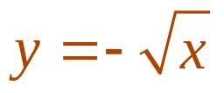
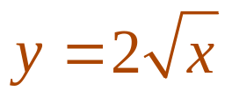
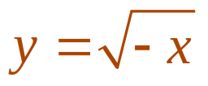
NEW FUNCTIONS FROM OLD FUNCTIONS
Label the following graph from the graph of
the function shown in the part (a):
y=f(x)-2, y=f(x-2), y=-f(x), y=2f(x), y=f(-x)?
  by reflecting about the x-axis.
  by stretching vertically by a factor of 2.
  by reflecting about the y-axis

Slide 30
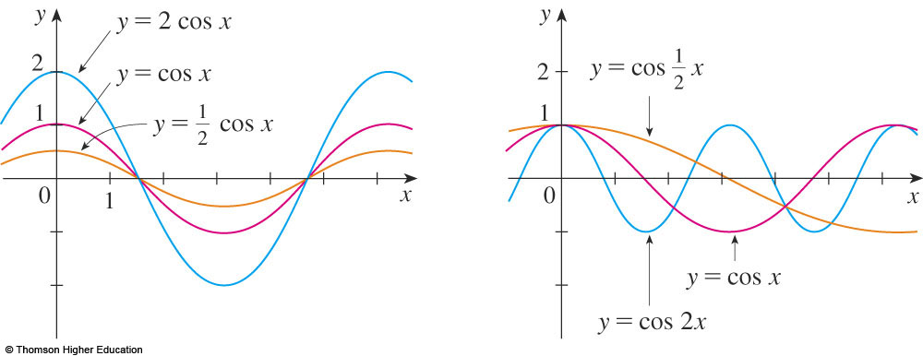
TRANSFORMATIONS
The figure illustrates these stretching
transformations when applied to the cosine
function with c = 2.

Slide 31
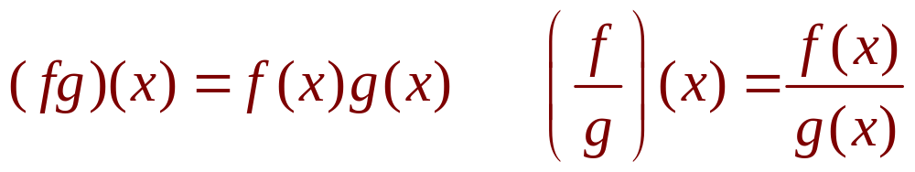
COMBINATIONS OF FUNCTIONS
Two functions f and g can be combined to form new functions:
  (f + g)x = f(x) + g(x)
  (f – g)x = f(x) – g(x)

Slide 32
LIMITS
1.3
The Limit of a Function
In this section, we will learn:
About limits in general and about numerical
and graphical methods for computing them.

Slide 33
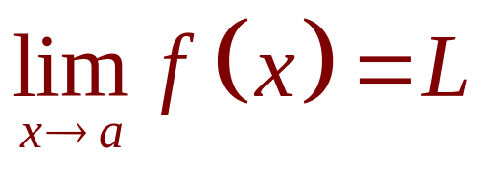
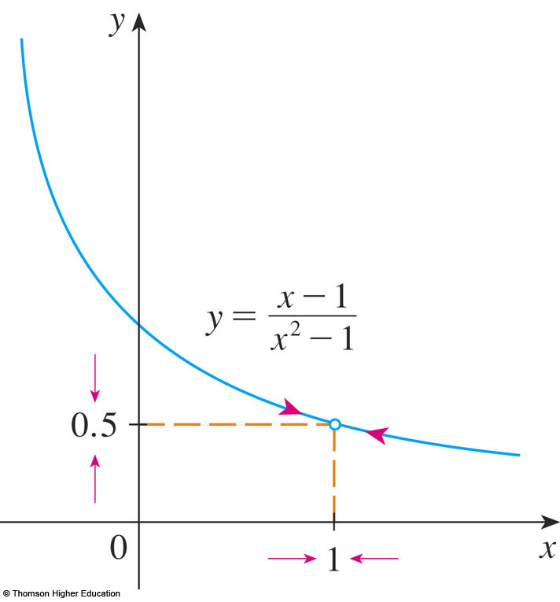
THE LIMIT OF A FUNCTION
In general, we write
if we can make the values
of f(x) arbitrarily close to L
by taking x to be
sufficiently close to a
but not equal to a.

Slide 34
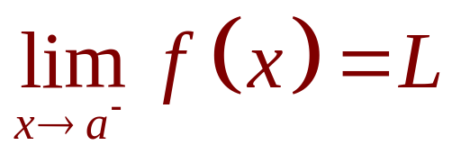
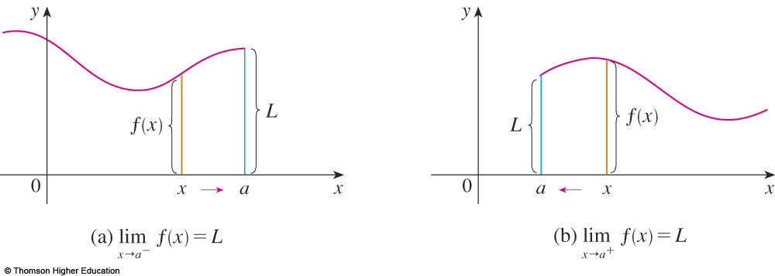
ONE-SIDED LIMITS
Definition 2
We write
if we can make the values of f(x) arbitrarily close to L by taking x to be sufficiently close to a and x less than a.

Slide 35
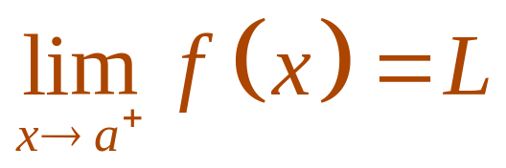
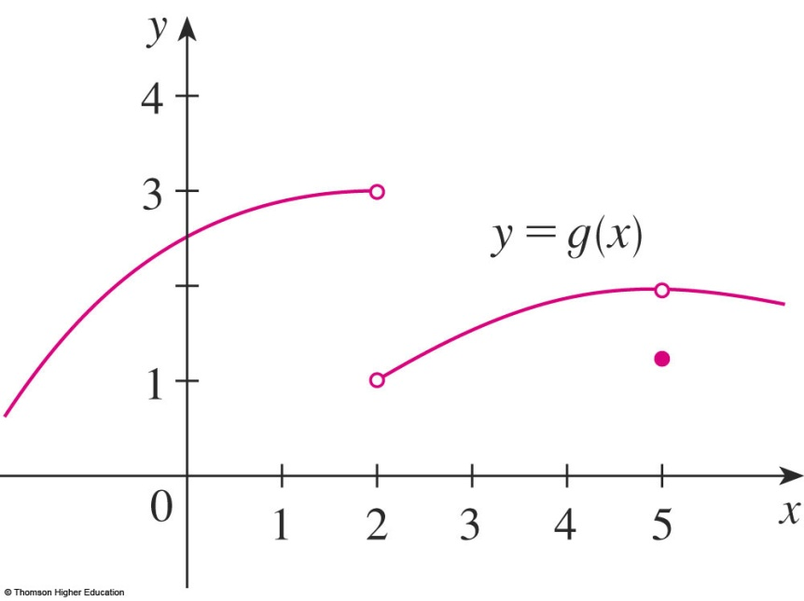
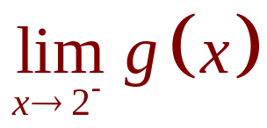
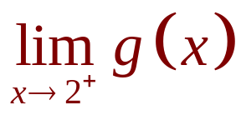
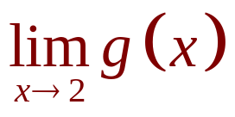
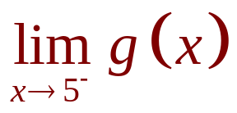

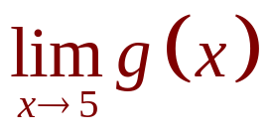
ONE-SIDED LIMITS
Similarly, “the right-hand limit of f(x) as x approaches a is equal to L” and we write

Slide 36
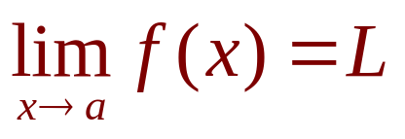
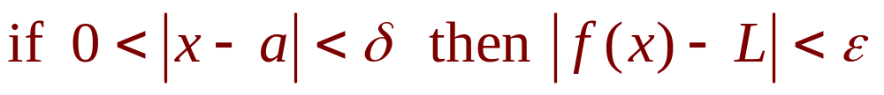
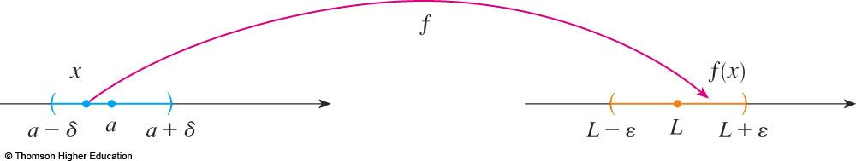
PRECISE DEFINITION OF LIMIT
Definition 2
Let f be a function defined on some open interval that contains the number a, except possibly at a itself. Then,
we write
if, ∀ε>0, ∃δ>0 such that

Slide 37
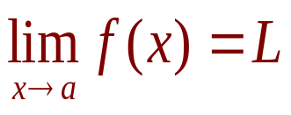

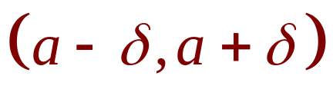

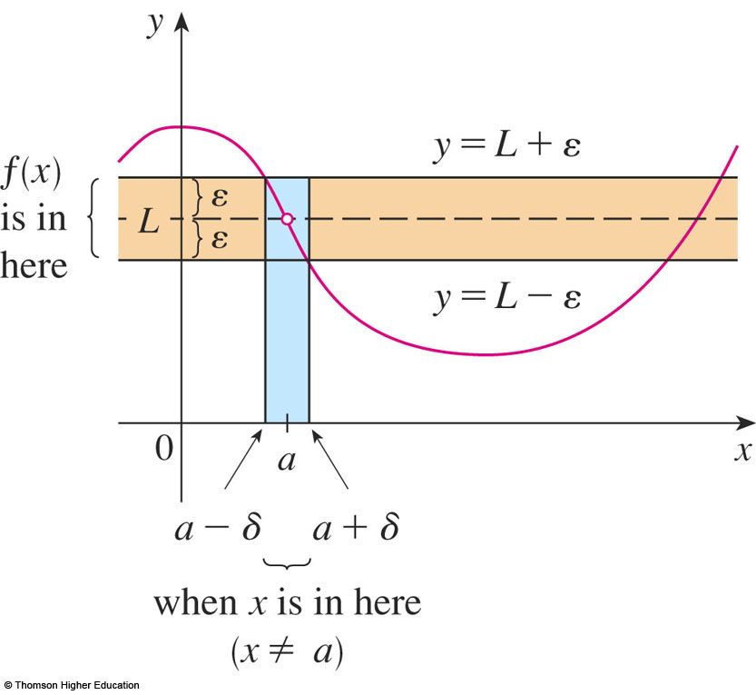
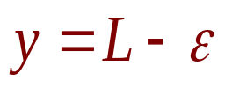

PRECISE DEFINITION OF LIMIT
If , then we can find a number
such that, if we restrict x to lie in the interval
and take , then the curve
y = f(x) lies between
the lines
and .

Slide 38
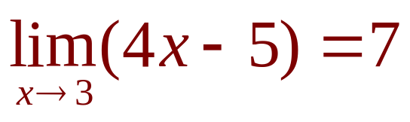
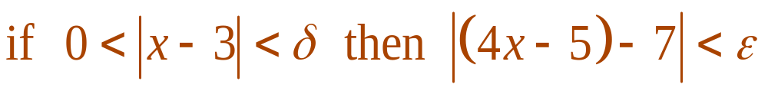
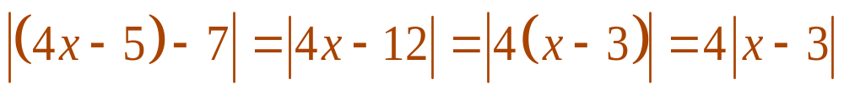
PRECISE DEFINITION OF LIMIT
Example 2
Prove that:
The first step is the preliminary analysis - guessing a value for δ.
  Let ε be a given positive number.
  We want to find a number δ such that
  However,

Slide 39
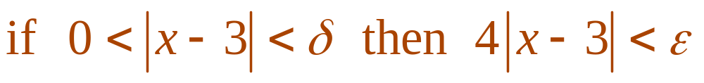
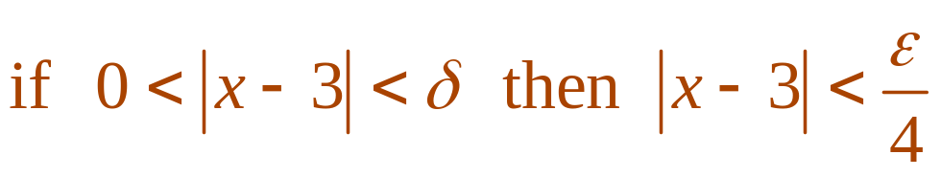
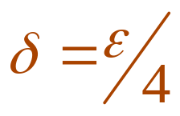
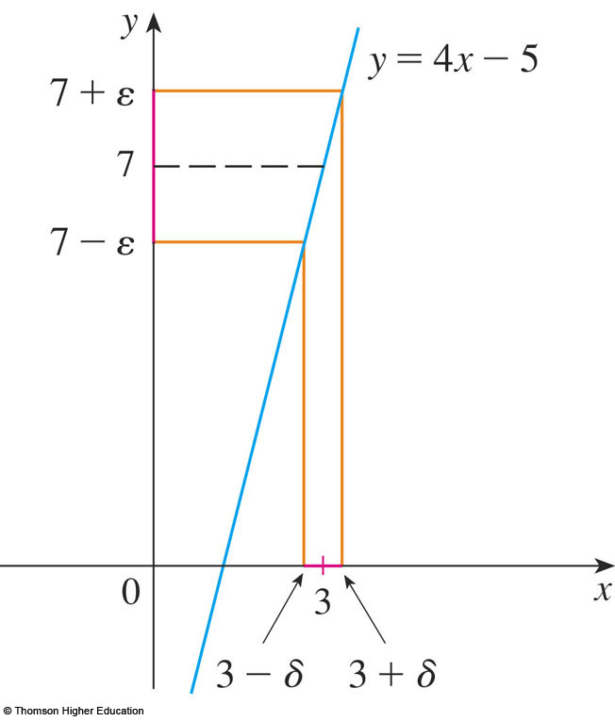
STEP 1: GUESSING THE VALUE
Example 2
Therefore, we want
That is,
This suggests that we should choose
The second step is the proof - showing that this δ works.

Slide 40
LIMITS
1.4
Calculating Limits
Using the Limit Laws
In this section, we will:
Use the Limit Laws to calculate limits.

Slide 41
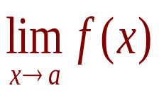





THE LIMIT LAWS
Suppose that c is a constant and the limits
and exist. Then

Slide 42






USING THE LIMIT LAWS
where n is a positive integer.

Slide 43


USING THE LIMIT LAWS
Theorem 1
if and only if

Slide 44


USING THE LIMIT LAWS
Example 8
Prove that does not exist.

Slide 45


PROPERTIES OF LIMITS
Theorem 2
If when x is near a (except possibly at a) and the limits of f and g both exist as x approaches a, then

Slide 46




SQUEEZE THEOREM
Theorem 3
The Squeeze Theorem (the Sandwich Theorem or the Pinching Theorem) states that, if
when x is near a (except possibly at a) and .Then

Slide 47



USING THE LIMIT LAWS
Example 11
Show that
  Note that we cannot use
  This is because does not exist.

Slide 48




USING THE LIMIT LAWS
Example 11
  However, since ,
  we have:
Taking f(x) = -x², and h(x) = x²
in the Squeeze Theorem,
we obtain:

Slide 49
LIMITS
1.5
Continuity
In this section, we will:
See that the mathematical definition of continuity
corresponds closely with the meaning of the word
continuity in everyday language.

Slide 50



CONTINUITY
1. Definition
A function f is continuous at a number a if:
Notice that :
  f(a) is defined - that is,
  a is in the domain of f
  exists.

Slide 51

CONTINUITY
Definition
If f is defined near a - that is, f is defined on an open interval containing a, except perhaps at a - we say that f is discontinuous at a if f is not continuous at a.
The figure shows the graph of a function f.
At which numbers is f discontinuous?
Why?

Slide 52


CONTINUITY
2. Definition
A function f is continuous from the right
at a number a if
and f is continuous from the left at a if

Slide 53
CONTINUITY
3. Definition
A function f is continuous on an interval if it is continuous at every number in the interval.
  If f is defined only on one side of an endpoint of the interval, we understand ‘continuous at the endpoint’ to mean ‘continuous from the right’ or ‘continuous from the left.’

Slide 54

CONTINUITY
4. Theorem
If f and g are continuous at a; and c is a constant, then the following functions are also continuous at a:
1. f + g
2. f - g
3. cf
4. fg
5.

Slide 55
CONTINUITY
7. Theorem
The following types of functions are continuous at every number in their domains:
  Polynomials
  Rational functions
  Root functions
  Trigonometric functions

Slide 56



CONTINUITY
8. Theorem
If f is continuous at b and then
In other words,
  If x is close to a, then g(x) is close to b; and, since f
  is continuous at b, if g(x) is close to b, then f(g(x))
  is close to f(b).

Slide 57

CONTINUITY
9. Theorem
If g is continuous at a and f is continuous at g(a), then the composite function
is continuous at a.
  This theorem is often expressed informally by saying
  “a continuous function of a continuous function is
  a continuous function.”

Slide 58


INTERMEDIATE VALUE THEOREM
10. Theorem
Suppose that f is continuous on the closed interval
[a, b] and let N be any number between f(a) and f(b), where
Then, there exists a number c in (a, b) such that f(c) = N.

Slide 59




INTERMEDIATE VALUE THEOREM
Example 9
Show that there is a root of the equation
between 1 and 2.
  Let .
  We are looking for a solution of the given equation—
  that is, a number c between 1 and 2 such that f(c) = 0.
  Therefore, we take a = 1, b = 2, and N = 0 in the theorem.
  We have
  and

Slide 60
1.6
Limits involving infinity
We will study:
Infinity Limits
Limits at Infinity

Slide 61


INFINITE LIMITS
Definition 4
Let f be a function defined on both sides of a, except possibly at a itself. Then,
means that the values of f(x)
can be made arbitrarily large
by taking x sufficiently
close to a,but not equal to a.

Slide 62



INFINITE LIMITS
Definition 6
Let f be a function defined on some open interval that contains the number a, except possibly at a itself.
Then, means that, ∀M>0, ∃δ>0 such
that

Slide 63


INFINITE LIMITS
Definition 5
Let f be defined on both sides of a, except possibly at a itself. Then,
means that the values of f(x)
can be made arbitrarily
large negative by taking x
sufficiently close to a,
but not equal to a.

Slide 64





INFINITE LIMITS
Similar definitions can be given for the one-sided limits:

Slide 65
DEFINITIONS
x=a is called the vertical asymptote of f(x) if we have one of the following:

Slide 66



LIMITS AT INFINITY
Let f be a function defined for every x>a. Then
means that

Slide 67

DEFINITION
The line y=L is called the horizontal asymptote of f(x) if we have one of the following:

Slide 68



Find the asymptotes of the function
Solution
y=1 is horizontal asymptote

Slide 69
Thanks

